Slide 1

Breaking Into the lucrative movie industry
A historical data analysis on the movie industry
by Brian Bentson

Slide 2
Recommendations
Analysis shows…
Create a horror movie with elements of the thriller and mystery genres
Release the movie in October or over the summer
Spend between $10 and $25 million

Slide 3
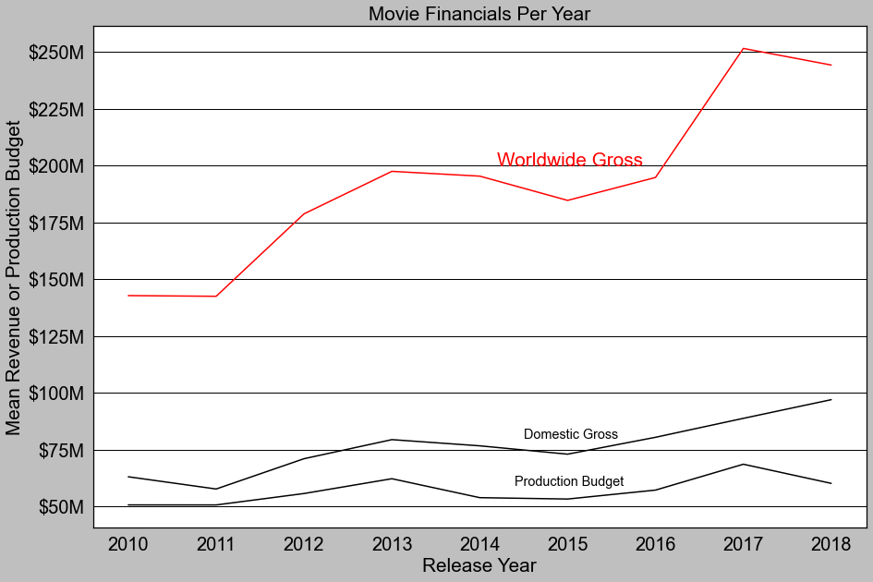
Never been a better time To invest
Worldwide revenue growth has increased significantly over the past 10 years
71%
increase in worldwide gross revenue in last 10 years
BUT…
15%
of movies do not make their money back

Slide 4



A word on data
Analysis parameters
Used imdb, tmdb, and rotten tomatoes data
Movies from 2010-2018
Top 40 studios only
”successful” Horror movies only

Slide 5
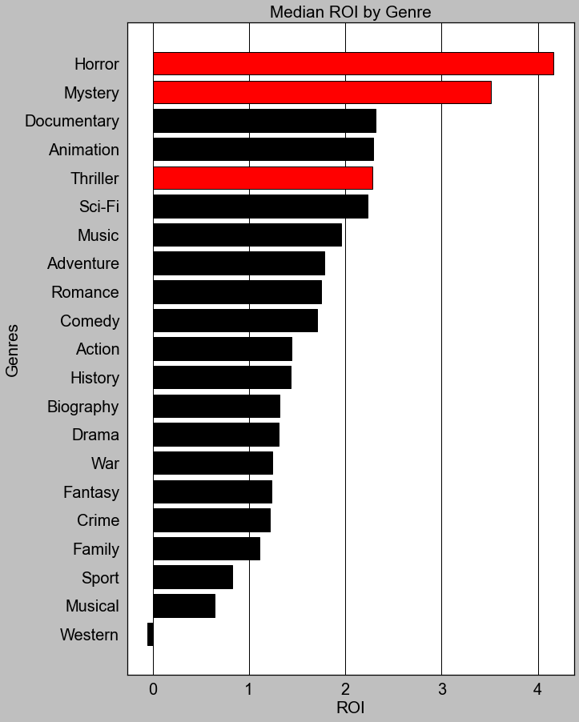
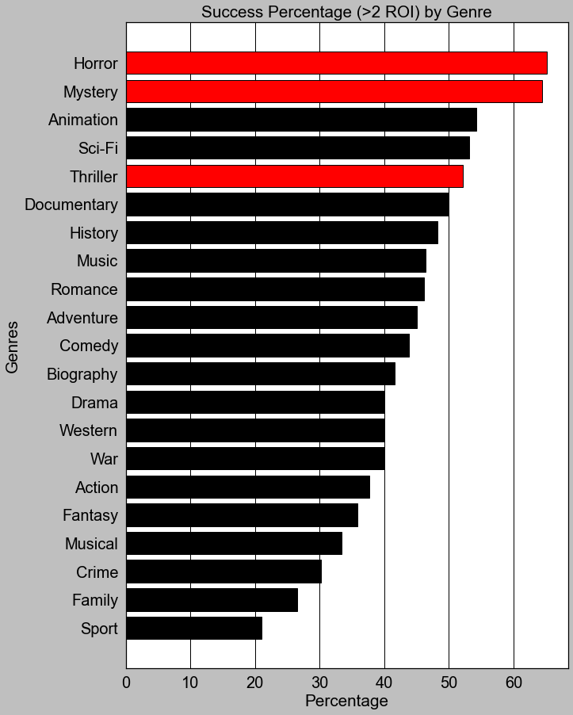
Horror offers high ROI & success rate
when comparing ROI and success rate amongst genres
Horror is…
89%
Likely to breakeven vs 80% average
61%
Likely to produce a ROI > 2 vs 41% average

Slide 6
Horror movies
Evaluating Horror movie recommendations

Slide 7
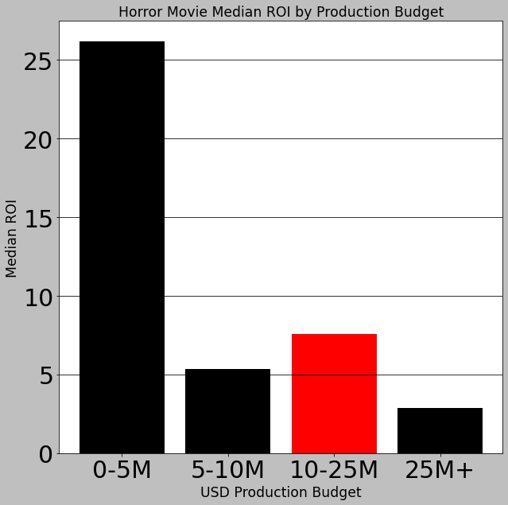
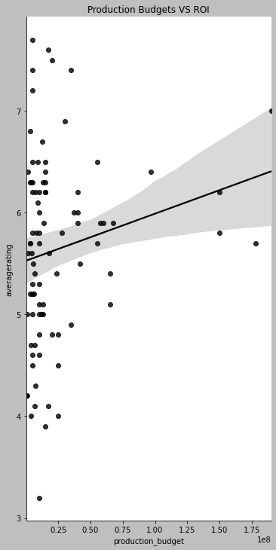
Spend Between $10M and $25M
Based on historical spend of successful Horror films
$85M-
$105M
Expected profit when spending between $10M and $25M
Successful Horror Films from Big Studios
The Gallows, Warner Bros
The Devil Inside, Paramount
Paranormal Activity, Paramount
Get Out, Universal
The Last Exorcism, Lionsgate

Slide 8
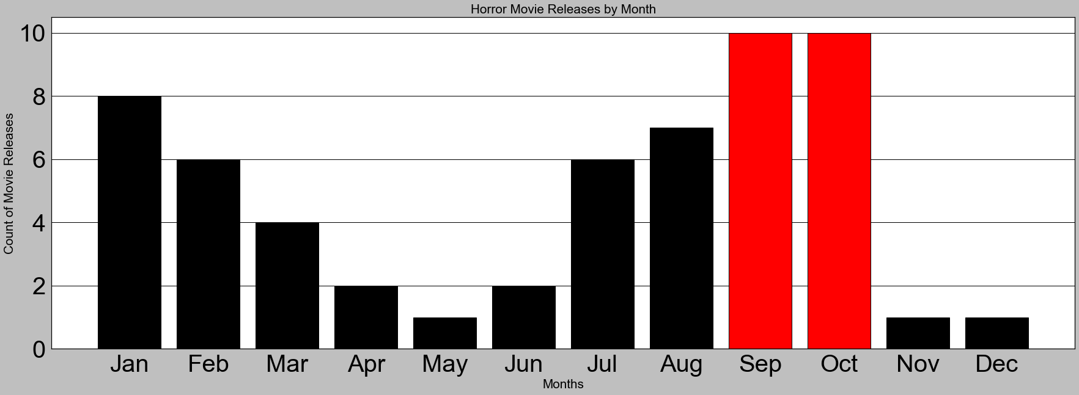
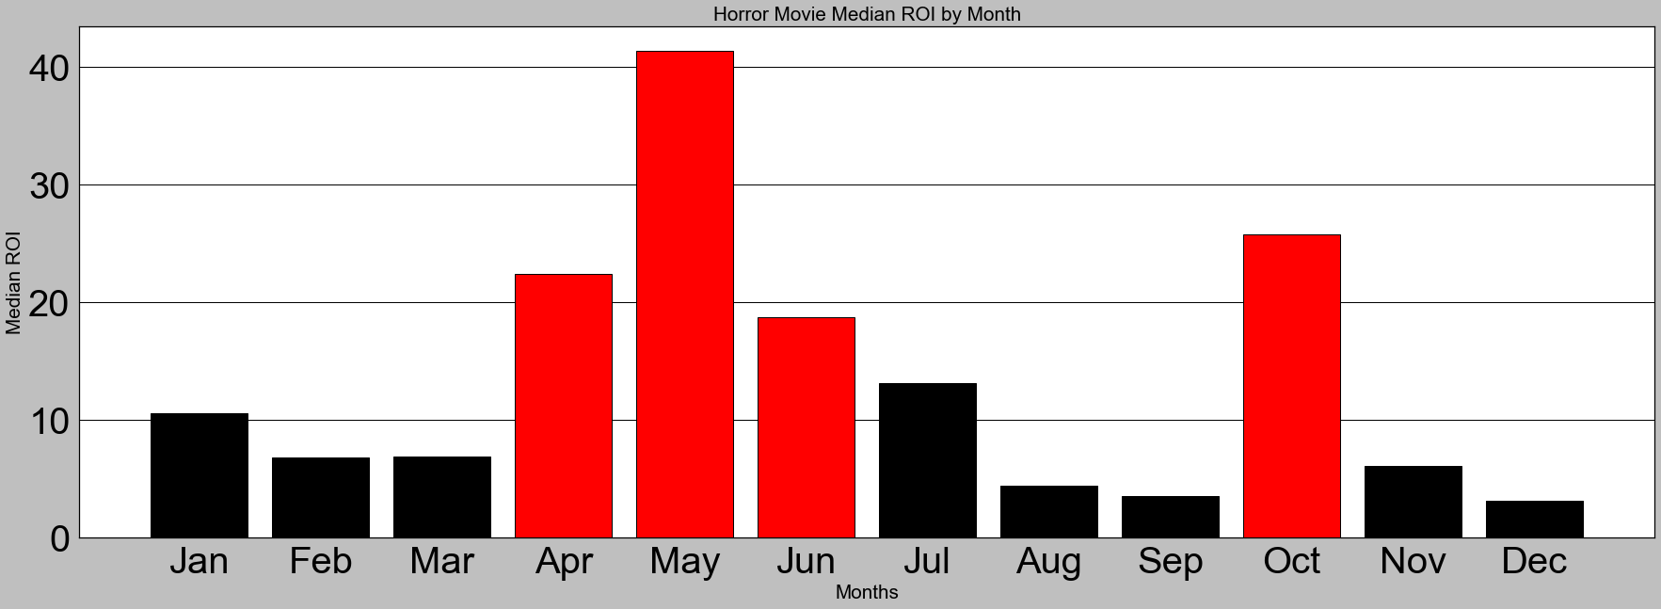
Release in October or summer
When evaluating historical ROI by release month of successful horror movies
Nov
Most common release month for all movies (11%)
Jul
Highest ROI month for all movies (32% higher than average)

Slide 9
High Roller Alternative
Evaluating Horror movie recommendations

Slide 10
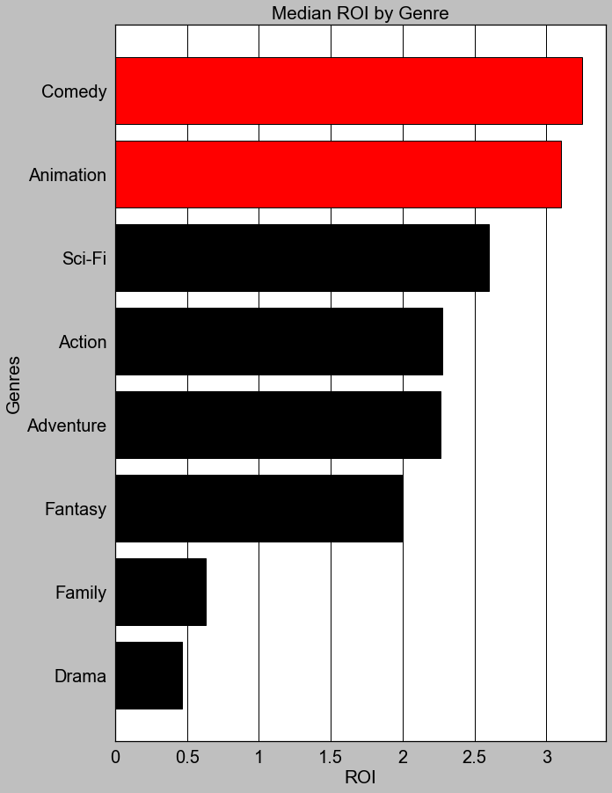
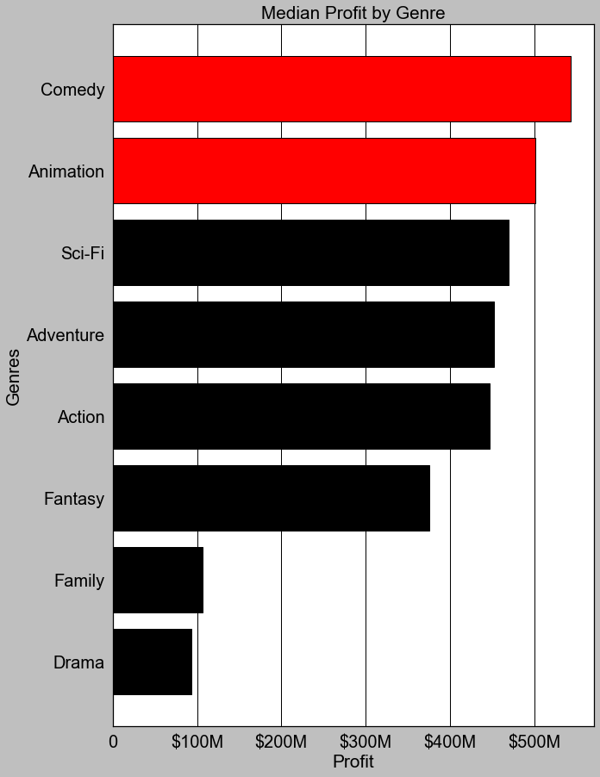
Invest in Animation OR Comedy
If you want to spend more than $150M (90th percentile)
9X
More profit compared to Horror
17X
More costly to produce compared to Horror

Slide 11
Conclusions
Great time to make a movie
Horror movies provide the lowest risk, highest roi investment
Expect to spend Between $10M-$25M and make between $85M-$105M
Release in October or during the summer
Plan next move toward animated comedies as budget permits

Slide 12
Next steps for deeper analysis
Identify top directors
Choose different metric for success such as total profit
Exploring revenue beyond the box office
Integrate popularity measures (awards, social media etc.)
Acquisition of successful movie studios

Slide 13
Thank you

